Slide 1

B.Tech External Project Evaluation, VIIIth Sem
Project Title-Real Time Sign Language Detection for Deaf and Mute Using OpenCV and CNN
Presented by :
Kartik Tripathi (2019554678)
Md Zunad Alam (2019001796)
Shrusti Sanket (2019501386)
Under the Supervision of:-
Ms. Gunjan Aggarwal
DEPARTMENT OF COMPUTER SCIENCE & ENGINEERING
SHARDA SCHOOL OF ENGINEERING AND TECHNOLOGY
1

Slide 2



Contents of the Presentation
Introduction to the project
Motivation for the project
Problem Statements/Objectives of the Project
Workflow
System Requirement
Methodology used
Detailed Design
Application of sign language detection
Conclusion
Outcomes Proof

Slide 3
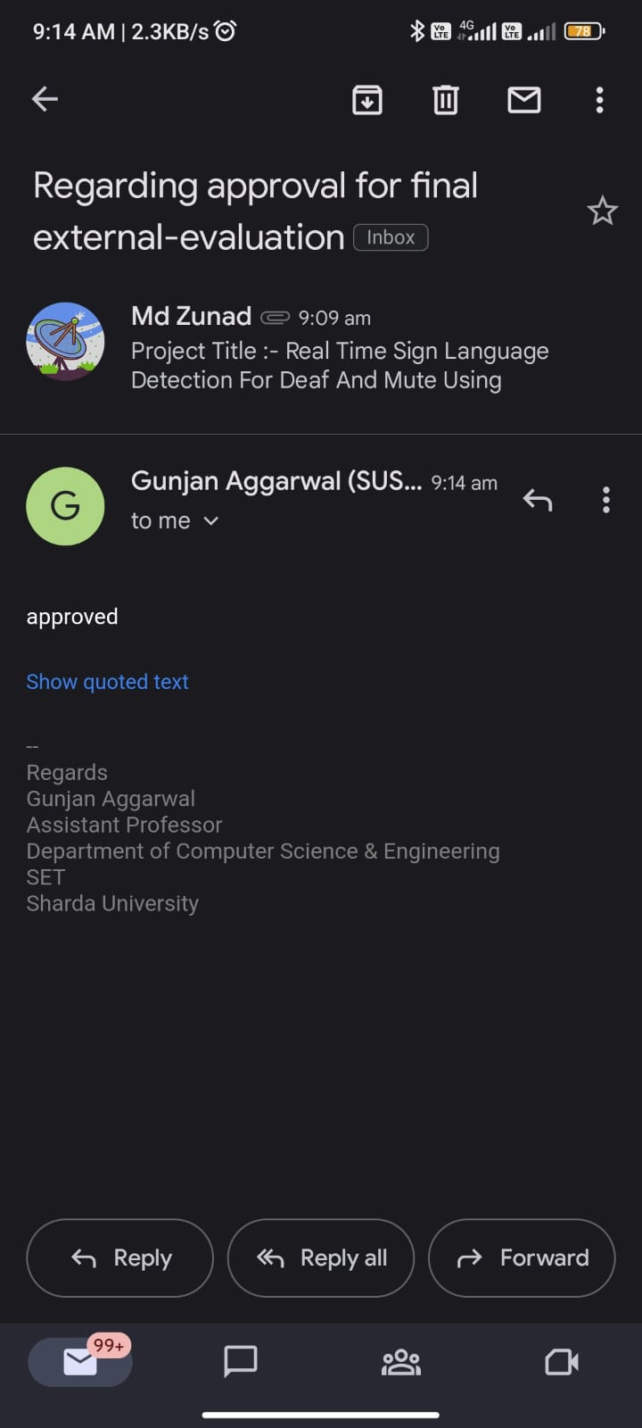
APPROVAL FROM GUIDE FOR THE EVALUATION

Slide 4
Introduction
Sign language detection is the process of recognizing and interpreting sign language gestures in order to translate into written language. This technology is particularly useful for facilitating communication between deaf or hard of hearing individuals and those who do not know sign language.
There are many different sign languages in use around the world, each with its own grammar and vocabulary. Some of the most widely used sign languages include American Sign Language (ASL), British Sign Language (BSL), and Indian Sign Language (ISL).
There are several different methods for sign language detection, including using computer vision techniques to detect and recognize hand and body movements, and machine learning algorithms to interpret and translate the gestures into written or spoken language.
Computer vision techniques involve analyzing video footage or images of the signer and tracking the movement of the hands and body. This can be done using various types of sensors such as cameras and depth sensors, and by applying techniques such as image processing and pattern recognition.

Slide 5
Cont..
Machine learning algorithms are trained on large datasets of sign language gestures to learn how to recognize and interpret different signs.
Sign language detection has the potential to revolutionize the way that deaf and hard of hearing individuals communicate with the hearing world. Additionally, it can be applied to increase accessibility in a range of contexts, including healthcare, education, and public transportation. However, there are still challenges in the development of this technology, such as the need for more robust and accurate detection algorithms, and the need for greater standardization of sign language vocabulary and grammar.
Learning sign language is a valuable skill for anyone looking to communicate with deaf or hard of hearing individuals, and it can also be a way to enhance communication skills in general. Many resources are available to help individuals learn sign language, including books, online courses, and classes offered through community organizations and schools.

Slide 6
Motivation for the project
There are several motivations behind a sign language detection project
Communication: Sign language is a rich and complex language with its own grammar and syntax. By developing a system that can detect and translate sign language, we can facilitate communication between people who may not speak the same language or who have different communication needs.
Education: Sign language is often used in educational settings for children who are deaf or hard of hearing. By developing a system that can detect and translate sign language, we can help teachers and students communicate more effectively, improving learning outcomes for students.
Technology: Sign language detection is an interesting and challenging technical problem that requires the use of computer vision, machine learning, and natural language processing techniques. Developing such a system can advance our understanding of these fields and lead to the development of new technologies.

Slide 7
Problem Statements
In order to facilitate communication between Deaf & Mute individuals and hearing people, a language system is formed by the structure of sign language, which is distinct from written language. In order to engage, they rely on vision-based communication.
The actions can be clearly understood by other individuals if there is a standard interface that transforms sign language to text. As a result, research has been done on a vision-based communication system that will allow Deaf & Mute persons to communicate without actually speaking the same language.
The goal is to create a human computer interface (HCI) that is simple to use and can recognize human sign language. Worldwide, there are many different sign languages, including the American Sign Language (ASL), French Sign Language, British Sign Language (BSL), Indian Sign Language, and Japanese Sign Language. Work has also been done on other sign languages.

Slide 8
System Requirement
Software
Python
TensorFlow
NumPy
Pip
Hardware
Processor: intel core i5 or above
64-bit, quad-core, 2.5GHz minimum per core
Ram: 4Gb or more
Hard disk: 10 Gb or above
Operating system: windows, Mac, etc.

Slide 9
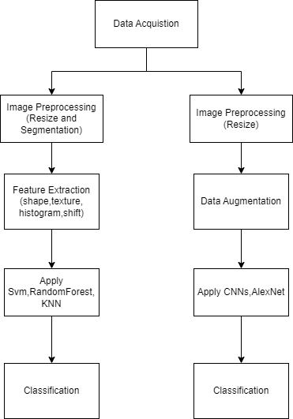
Workflow

Slide 10
Methodology used
Input Images
This is the first step of our proposed model in which we give input video stream.
Augmentation of images
The quantity of pictures is less so in order to increase. The quantity of images in dataset, we need to perform the augmentation process. It is one of the most useful techniques which helps to increase the size of data without need of new images.
Preprocessing
In order to enhance the quality of the hand gesture image, pre-processing is a crucial and initial step. Impulsive noise reduction and image scaling are crucial pre-processing procedures. In the initial stage, we crop the images and convert the hand image into its equivalent gray-scale image. This raises the accuracy rate of classification and the diagnosis.

Slide 11
Cont..
Segmentation
Image segmentation is a method for dividing an image into various components. The main goal of this division is to keep the quality of the images while making it simple to examine and interpret them. In order to analyses the size, volume, position, texture, and shape of the extracted image, segmentation methods are useful since they have the ability to discover or identify the anomalous component from the image. The simplest technique for segmenting images is thresholding. The process of turning a greyscale image into a binary image, where the two levels are allocated to pixels with values above or below the set threshold value, is a non-linear operation.
Classification
Classification is one of the best ways to identify images, including any kind of medical imaging. Every algorithm for categorizing things is predicated on the notion that an image has one or more features, each of which is associated with a specific class. The constructed CNN model is used to categorize the words and display the appropriate results.

Slide 12
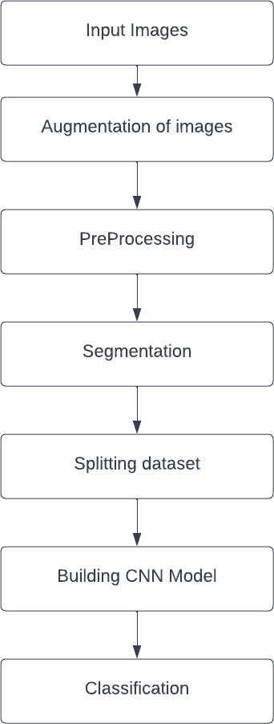
Cont..

Slide 13
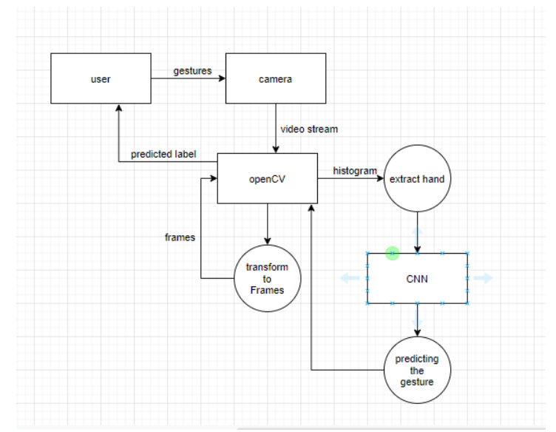
Proposed system

Slide 14
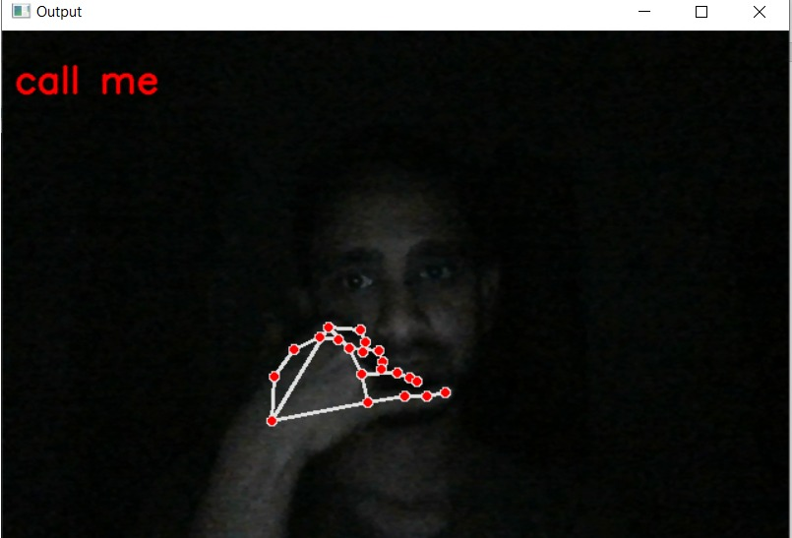
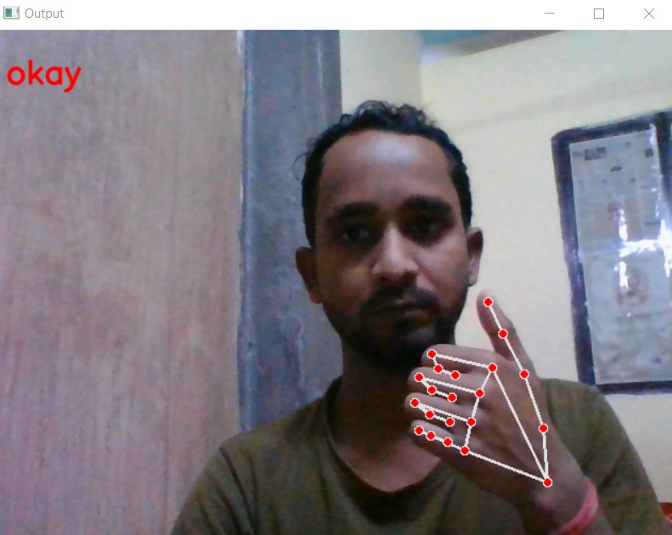
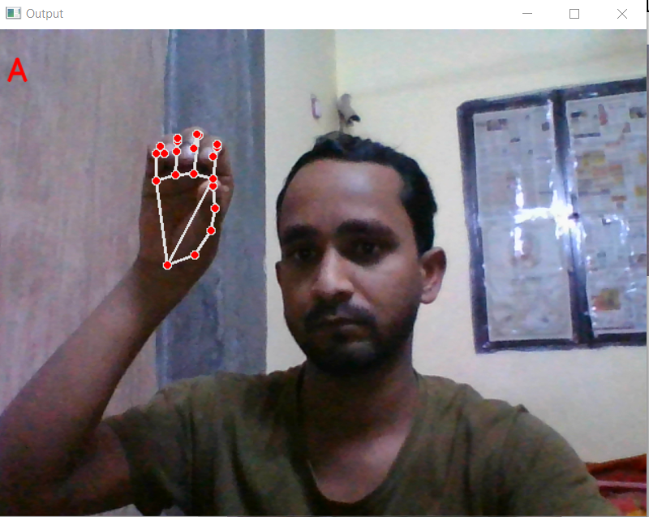
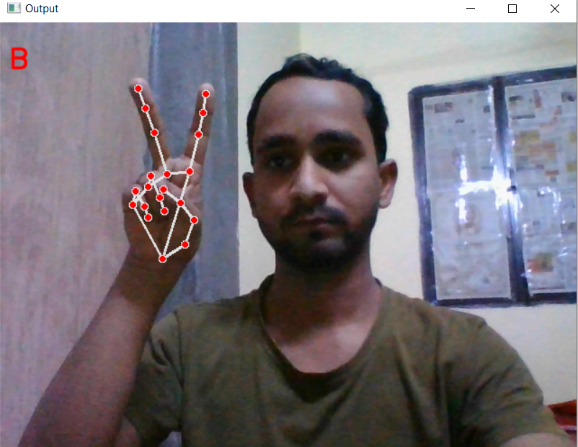
RESULT

Slide 15
Application of sign language detection
Sign language detection can be used to improve accessibility in public places, such as airports, hospitals, and government offices.
It can also be used in education to provide a more interactive and engaging way to learn sign language.
Sign language detection can be integrated into mobile devices and video conferencing software to improve communication between sign language users and non-sign language users.
It has the potential to revolutionize the way we communicate with the deaf or hard-of-hearing community.

Slide 16
Conclusion
Sign language detection has the potential to improve accessibility, communication, and education for the deaf or hard-of-hearing community.
By recognizing and translating sign language, we can bridge the communication gap between sign language users and non-sign language users.
With advancements in computer vision and machine learning, sign language detection is becoming more accurate and efficient, opening up new possibilities for innovation and progress.

Slide 17

Outcome Proof

Slide 18

Outcome Proof

Slide 19
THANK YOU

